Slide 1
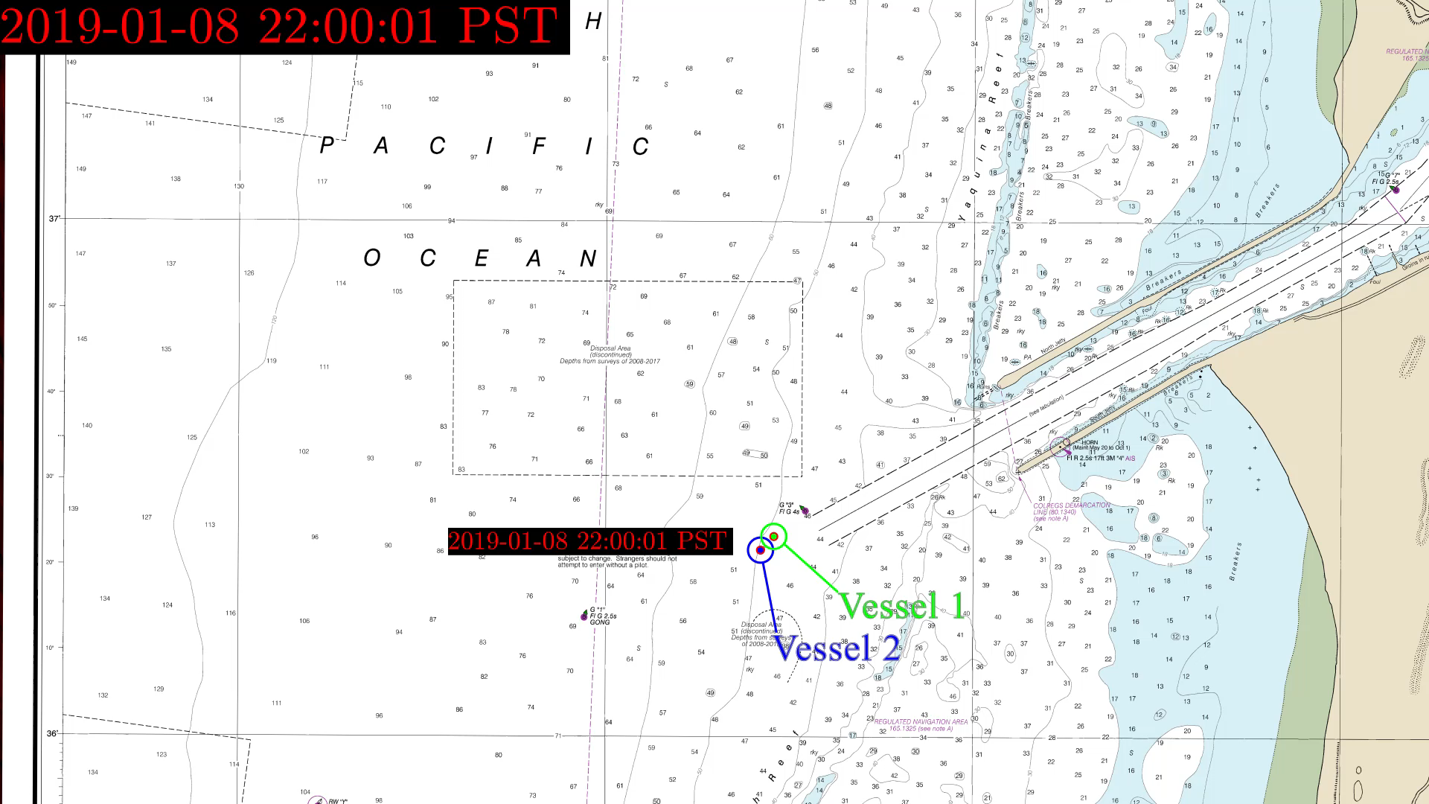
CG 035 OSU Product snap_event_navChart_1080_10rps

